Slide 1
Measuring Economic Freedom
Team lead - Harika
Team members - Deepa manasa, Hasini, Nikhil

Slide 2

Introduction
Economic freedom allows individuals to control their labor and property, facilitating choice in work, production, and investment. This freedom promotes prosperity, reducing poverty and ignorance globally, and it is pivotal in measuring progress through the Index of Economic Freedom.

Slide 3
Economic Freedom Overview

Slide 4

Why Economic Freedom?
Economic freedom is the fundamental right of individuals to make choices regarding their labor and property. So computing large static files for over a large period of time may reduce the efficiency and might lead to misinterpretations.

Slide 5
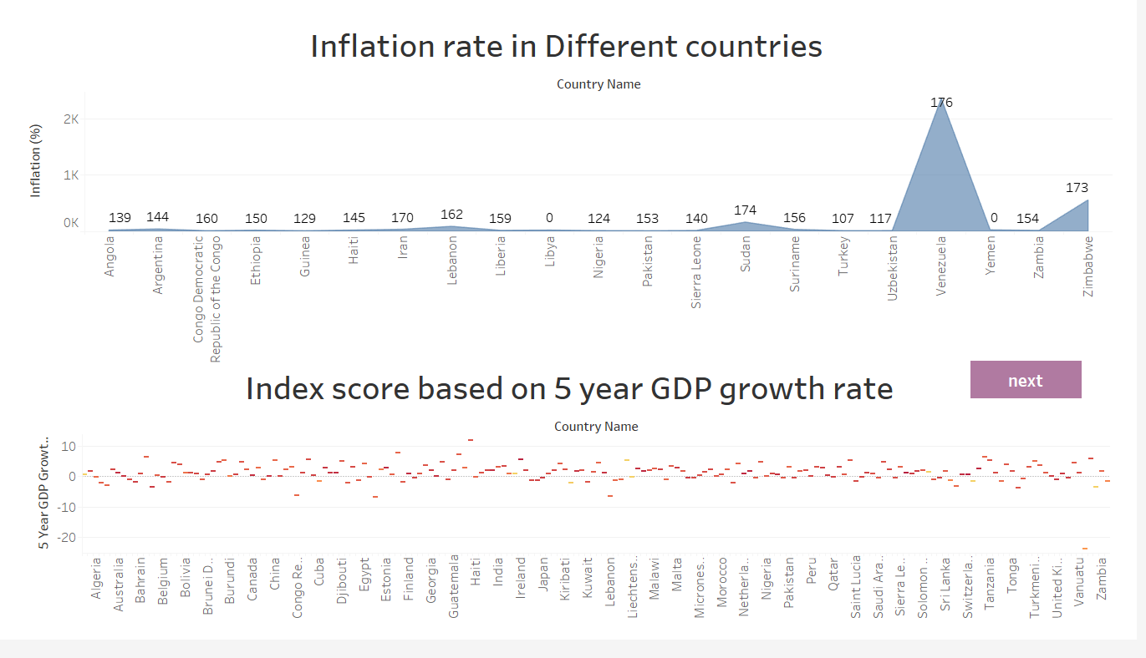
Historical Context of Economic Freedom
Historically, many societies have faced restrictions that limited economic opportunities, resulting in widespread poverty. The evolution of economic freedom has played a crucial role in enhancing individual welfare and national development throughout history.

Slide 6
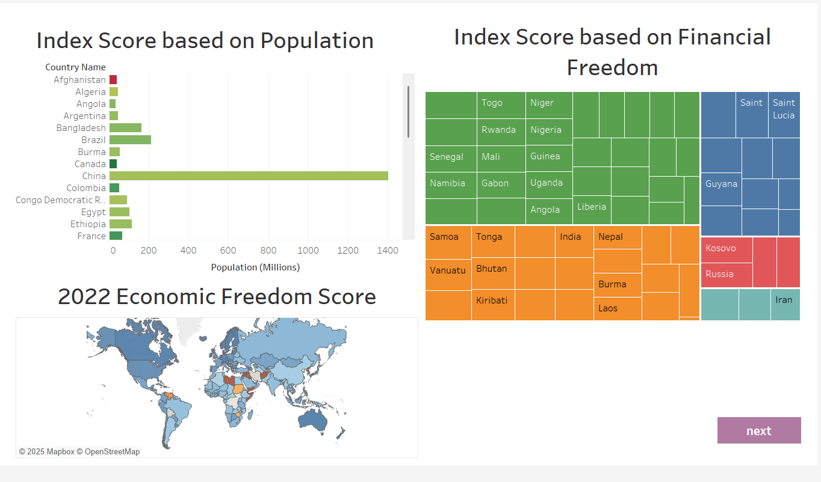
Importance of Economic Freedom Today
In today's world, economic freedom is crucial for fostering innovation, job creation, and overall societal progress. It empowers individuals to make choices that lead to better economic outcomes, reduces reliance on government, and ultimately enhances quality of life. As nations pursue economic freedom, they tend to experience greater prosperity and resilience against economic downturns.

Slide 7
Index of Economic Freedom

Slide 8
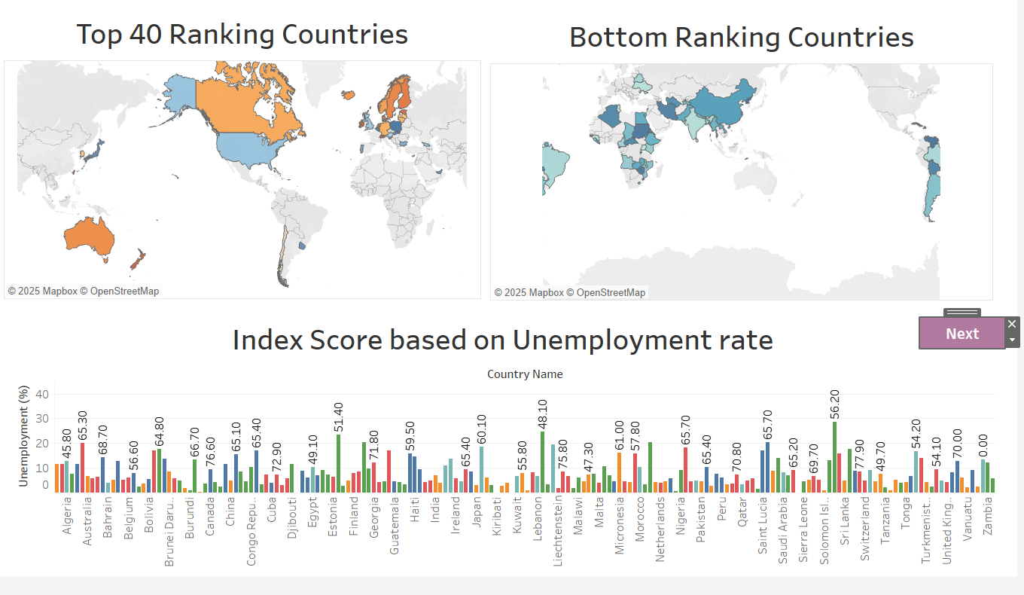
Measuring Economic Freedom
The Index of Economic Freedom measures economic freedom through various indicators assessing rule of law, government size, regulatory efficiency, and open markets. By analyzing these metrics, the index positions countries on a spectrum of economic freedom, revealing how policies impact individual liberties and economic growth.

Slide 9
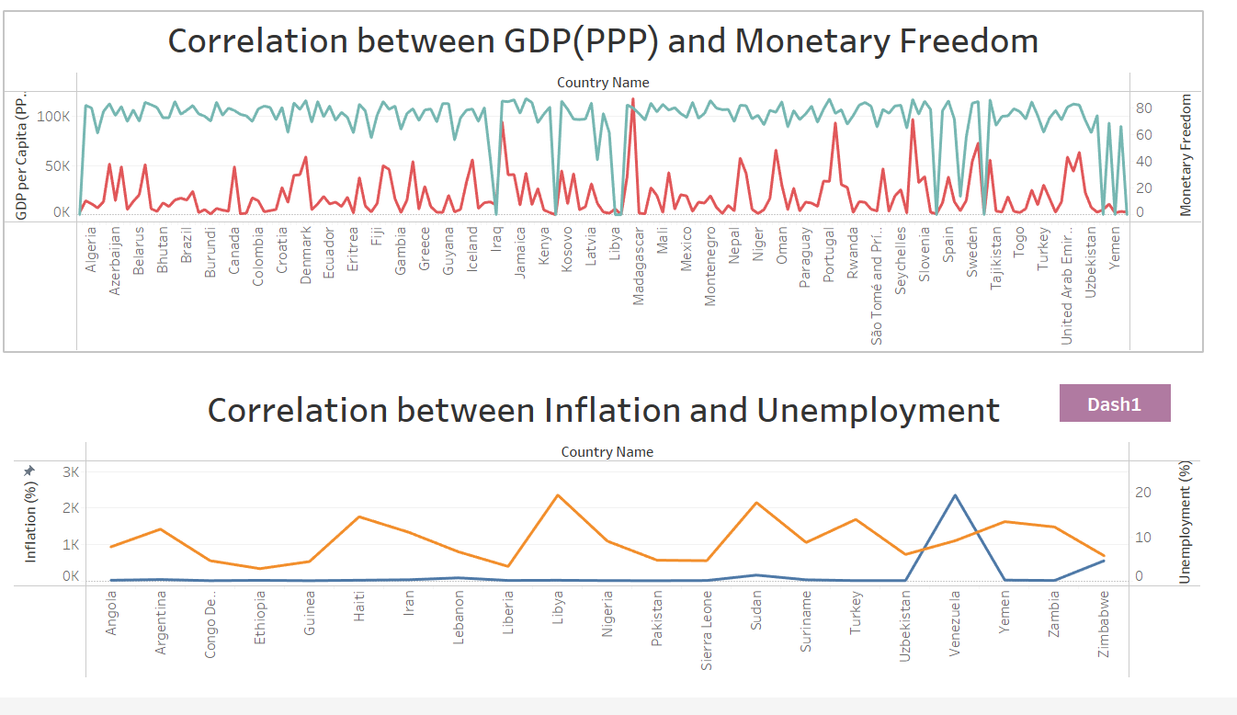
Categories of Economic Freedom
The Index is built around four main pillars: Rule of Law, which includes property rights and government integrity; Government Size, focusing on fiscal health and spending; Regulatory Efficiency, assessing business and labor freedom; and Open Markets, which encompasses trade and investment freedoms.

Slide 10

Analysis Results and Team Contribution
The analysis conducted through Tableau uncovered key insights regarding our regional economic freedom scores. Team members contributed significantly, leading to a collaborative approach that allowed for a thorough examination of the data. Our findings highlight areas for improvement and underscore the importance of economic policies in fostering an environment of economic freedom.

Slide 11
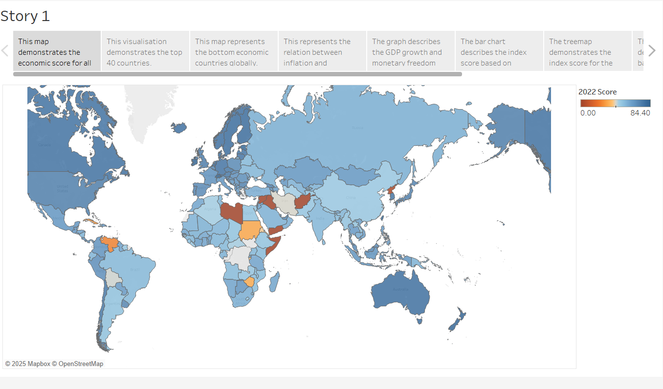
Conclusions
By using the interactive dashboards from tableau we concluded with a interactive story from the given dataset that interprets the various economic trends between the countries.

